Slide 1
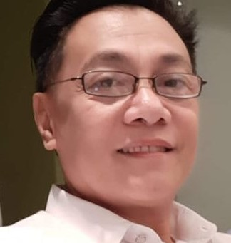
Understanding the Self
Elias D Dimaano, MAEd
COBM

Slide 2
Week 1
Orientation and Introduction
Welcome to:
FCPC
First City Providential College

Slide 3
Vision
The First City Providential College shall be a world-class university for lifelong learning.

Slide 4
Mission
First City Providential College shall:
Offer relevant and multidisciplinary academic programs to produce lifelong learners who are globally competitive and socially responsible professionals.
Produce viable researches for local and international publication and utilization.
Implement collaborative and sustainable community extension services.

Slide 5
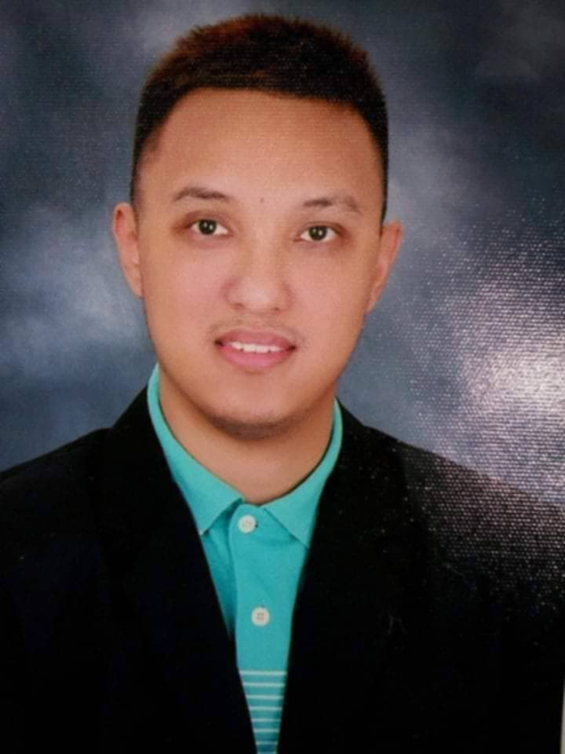
COBM
College of Business Management
Dean: Dr. Michelle Naig
Program Head: Dr. Alan Lancelot D. Makasiar

Slide 6
Expectations:
Prelim 30 points
Midterm 30 points
Finals 30 points
Final Exam / Field Fam 10 points

Slide 7
Understanding the Self
This course is intended to develop self-awareness and self-understanding. It aims to assist students in developing a holistic and integrated perspective of the self. Topics include personal development, self and identity, physical, mental, social, and digital aspects of the self. It emphasizes the value of self-care, goal-setting, and self-regulation as tools for academic and personal success

Slide 8
Expected Learning outcomes
Analyze various aspects of the self using concepts from different disciplines.
Apply insights from self-awareness and self-reflection to personal and academic life.
Demonstrate personal responsibility and goal-setting in line with holistic well-being.

Slide 9
Week 2

Slide 10
How do we view ourselves from different perspective
Philosophical perspective
Sociological perspective
Psychological perspective

Slide 11
Philosophical
We explore the nature of our identity
Our consciousness
Our existence
Socrates / Plato / Descartes / Hume and others

Slide 12
How do you define your own philosophy of SELF?

Slide 13
Week 3
Physical Self
Body image and self-concept
Biological and environmental influences
How does our physical body shape our self-concept?

Slide 14
How someone see himself
Physical appearance
(What do they feel about their body)
Self-concept
(broader perspective including abilities, personality, and self-worth)

Slide 15
Relationship between body image and self-concept
Good body image = good self-esteem
They influence each other

Slide 16
Effect in Mental Health
Depression
Eating disorder
Anxiety

Slide 17
Week 4
The sexual self
Sexual identity and gender roles
Influences on sexual behavior

Slide 18
Activity

Slide 19
Gender Roles
Feminine
Masculine
Importance of Gender Role
Self-esteem and identity
Strong relationship
Career choices
Sexism – based on gender

Slide 20
Changing Gender Roles
Awareness on the traditional roles
Expectations of the society
Diverse Roles
Flexibility in personal and professional life

Slide 21
Week 5
Possessions and the self
Consumer behavior and identity

Slide 22
How you perceive yourself and how others perceive you
Your possessions are considered an extension of you
Material possession – symbol of your identity
Self-possession – emotions / endurance
Loss (losing your possession) – grief
Ownership and identity - you in a group, you in a community

Slide 23
Week 6
Exam

Slide 24
Week 6
Exam

Slide 25
Week 7
The Digital Self
This applicable in today’s generation
Digital Era / Digital Age
discussion

Slide 26
Week 8
The Mental and Emotional Self

Slide 27
Mental Health
Ability to think, understand information, and live life to the fullest.
Decision-making
Stress

Slide 28
Emotional Health
Ability to grasp the what is happening around you related to feelings.
Express what you feel
Understand the feelings of others

Slide 29
Rational and Passionate
What is your understanding of being rational?
How about being passionate?
discussion

Slide 30
Aspects of Mental Health
Ability to think clearly – good decision
Rational thinking – problem-solving
Coping with stress – handle problems or difficult situations
Knowledge, creative, resilience
Self-Esteem

Slide 31
Aspects of Emotional Health
Management of emotions
Aware about their feelings
Management of positive and negative emotions
Develop safeguarding techniques in handlings negative emotions
Emotional stability

Slide 32
Handling both mental and emotions
Mindful – be aware of your feelings and thoughts
Support – ask help from professionals
Healthy habits – physically active and balanced diet
Resiliency – be able to stand again, failing or failure is part of the process

Slide 33
Week 9
The social self and relationships

Slide 34
Social self
A person’s identity influenced by interactions with others and the environment.
Perception of oneself in relation to society, their social roles, memberships, and feedback received.
Not inborn – self-concept it is dictated or a product of socialization

Slide 35
Aspect of Social Self
Social identity
Interactions with others
Social roles
Self perception and feedback

Slide 36
Influence of Social Self on Well-being
Crucial for overall mental well-being and the ability to achieve one’s goal
Can damage sense of self-esteem

Slide 37
Week 10
The political and economic self

Slide 38
Political self identity
Form of Social Identity marking membership of certain groups that share a common struggle for a certain form of power.
Includes identification with a political party, positions on specific political issues, nationalism, inter-ethnic relations or more abstract ideological themes.

Slide 39
Economic Self
Person’s identity and self-worth are shaped by their financial resources, possessions, and ability to meet economic needs.
Concept of material self – capacity to meet the needs based on income.

Slide 40
Components of economic self
Material possessions – one owns
Economic self sufficiency – ability to provide for oneself and one’s family without relying on any assistance
Identity of consumerism – consumption and accumulation of goods
Self-expression – use of economic choices and material belongings to express unique qualities, attitudes, group affiliationw=s

Slide 41
Importance of economic self
Self-definition
Financial decision-making
Social status

Slide 42
Week 11
Goal Setting and Personal Development

Slide 43
Goal Setting and Personal Development
Defining what you want to improve using the SMART framework
Specific
Measurable
Attainable
Relevant
Time-bound
Leading to self-confidence

Slide 44
Suggestion on how to put your goals into action
Write down your goals
Plan your steps
Track your progress
Develop growth mindset
Seek support

Slide 45
5 F’s of Goal Setting
Family and Friends
Finances
Fun
Faith
Fitness

Slide 46
Week 12
Midterm exam

Slide 47
Week 13
Self-Discipline and Self-Regulation

Slide 48
Week 14
Self – Care and Well - Being

Slide 49
Week 15
The Whole Self - Summary

Slide 50
Week 16
Who are you today?

Slide 51
Week 17
Review

Slide 52
Week 18
Final Exam

